Slide 1

Charla Técnica(SQL Server):
Qué sucede cuando se envía una consulta al motor?
Robert Rozas Navarro
@Hackerman | @AshWilliams
robert.rozas.n@outlook.com

Slide 2


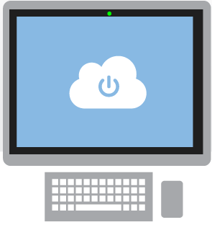
Agenda:
Visión General
Visión Específica
Planes de Ejecución
Estadísticas
Parameter Sniffing, SARGable
Demo PS y Mitigación

Slide 3
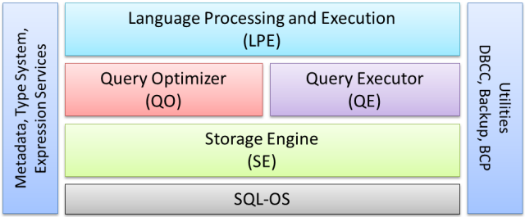
Visión General
SQL Server Core Engine
Notes:
Language Processing is concerned with things like parsing the text of the query to make sure it is syntactically valid, binding table references to real database objects, deriving types for expressions, semantic analysis (for example checking that the query is not trying to execute a table), and binding GROUP BY references to the appropriate logical scope. The Query Optimizer aims to find a good physical execution plan that matches the logical semantic of the query, and the Query Executor is responsible for running that plan to completion. Below that, the Storage Engine provides access to physical storage, together with locking and transaction services. Finally, SQL-OS is the layer that provides threading, memory management, and scheduling services.
SQLOS tiene muchas funciones asignadas (o sistemas que maneja), estas son algunas:
Detección de deadlocks
Manejo de recursos
Manejo de memoria
Scheduler de E/S

Slide 4
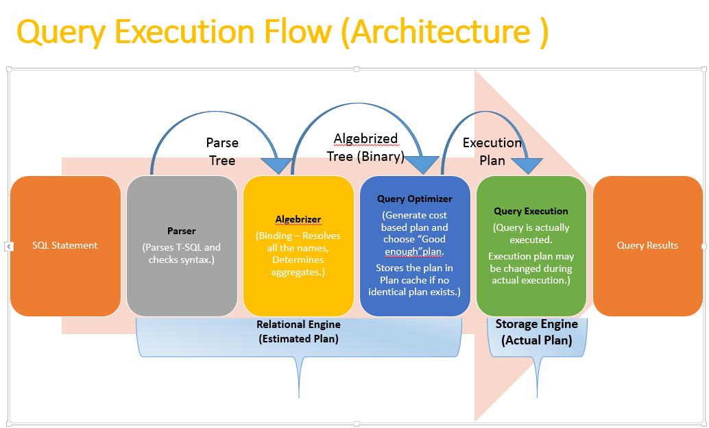

Slide 5

What is Microsoft Azure?
Azure is Microsoft’s cloud computing platform, a growing collection of integrated services—analytics, computing, database, mobile, networking, storage, and web—for moving faster, achieving more, and saving money.

Slide 6
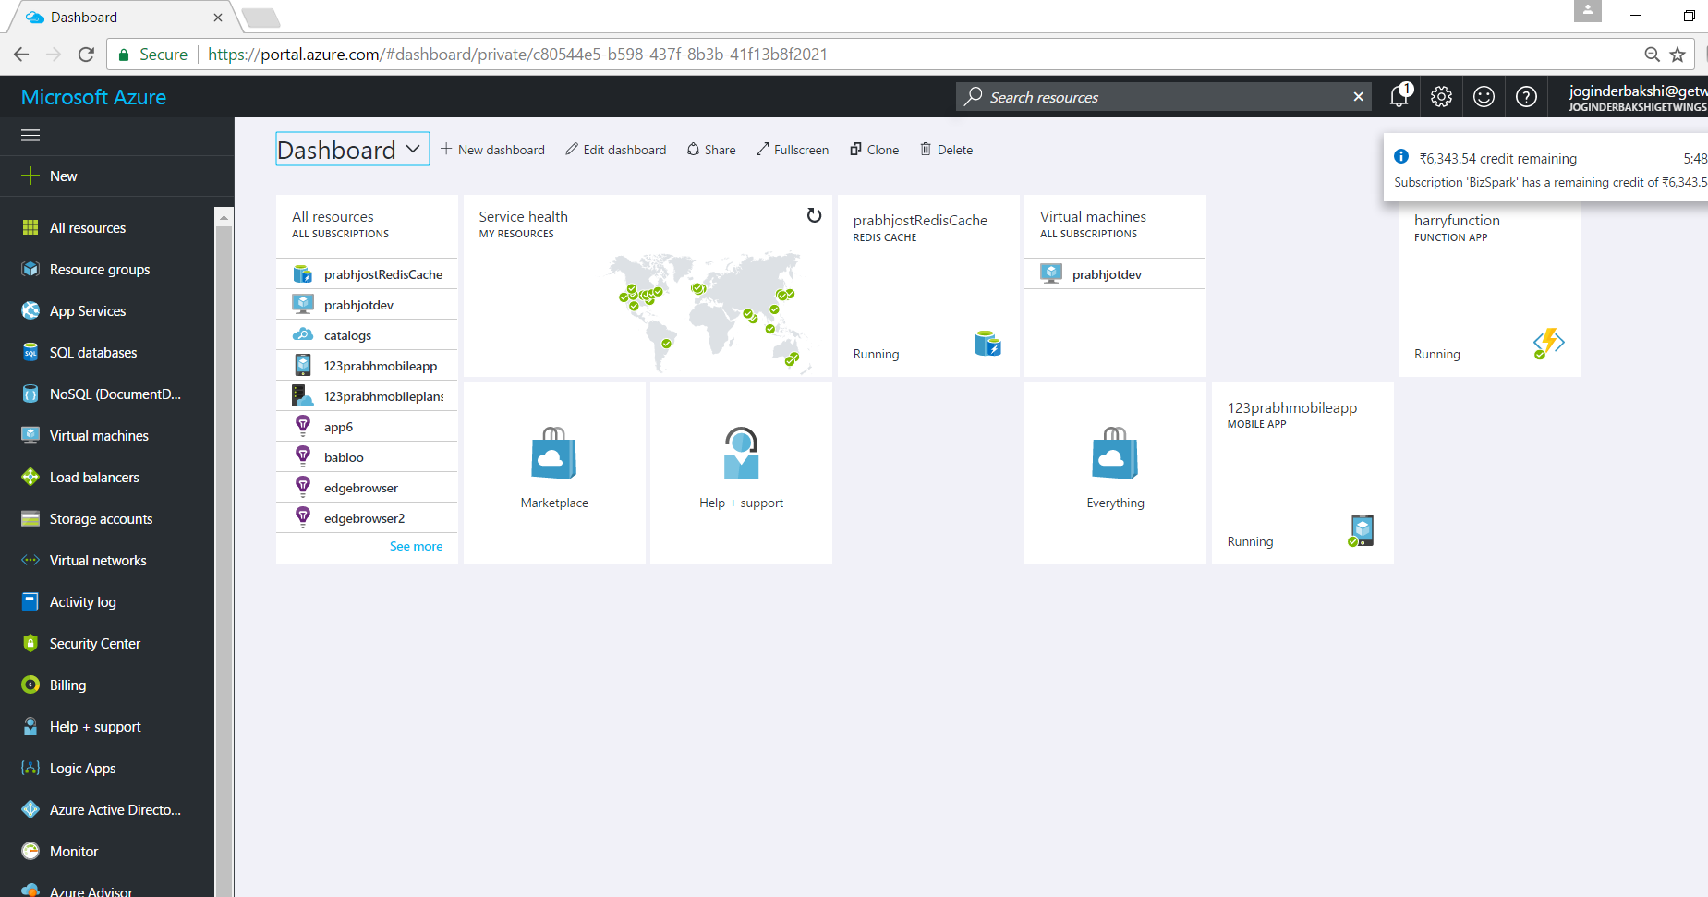
Demo – How the Azure Portal Looks likes

Slide 7
>90%
More than
1,400,000
>300k
Fortune 500 using Azure
Active websites
SQL Databases in Azure
>30
>300
>4
TRILLION storage objects
MILLION
AAD users
>3
MILLION requests/sec
>13
BILLION
MILLION
authentication/wk
Developers registered with Visual Studio Online
Notes:
This will give you idea about the scale and speed of cloud Azure
http://boards.microsoft.com/public/prism/72960?token=26a6b8ccef
https://www.onmsft.com/news/build-2016-85-fortune-500-use-azure-30-unique-azure-regions

Slide 8





















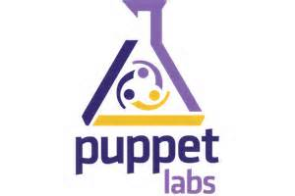












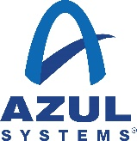




















Partners
Notes:
Here is the list of partners on Azure cloud solution

Slide 9
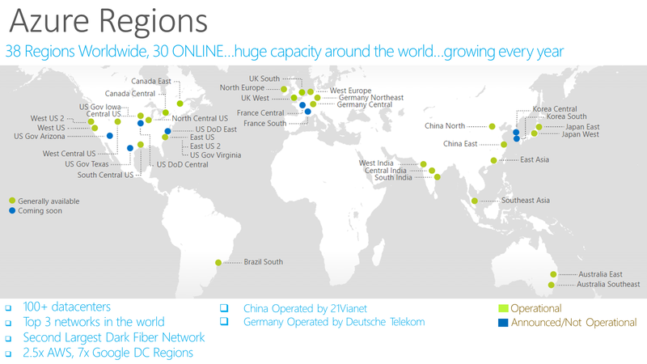
Notes:
https://azure.microsoft.com/en-us/regions/
Over the last few years we’ve truly delivered a huge infrastructure to enable us to grow our services at scale around the globe. Whether it’s our flagship facilities in Quincy, Washington or Boydton, Virginia, or some of the newly announced facilities in Shanghai, Australia and Brazil, it really is key for us to make smart investments around the world to deliver services in a resilient and reliable fashion.
A lot of people ask, what goes into site selection at Microsoft and how do we decide where to place our datacenter investments? There are over thirty-five factors in our site selection criteria. But really, the top elements are around proximity to customers and energy and fiber infrastructure, insuring that we have the capacity and the growth platforms to be able to grow our services.
Another key element is about skilled workforce. We need to insure that we have the right people to run and operate our datacenters on a day to day basis.

Slide 10
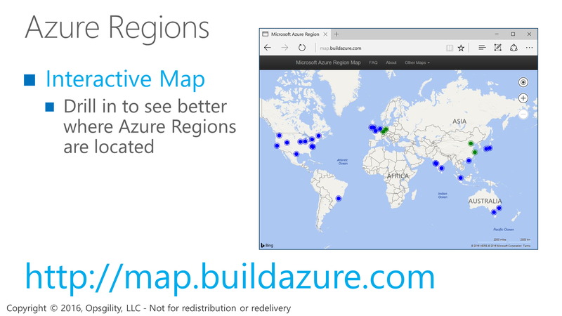
Azure Regions

Slide 11

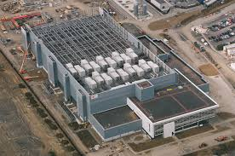
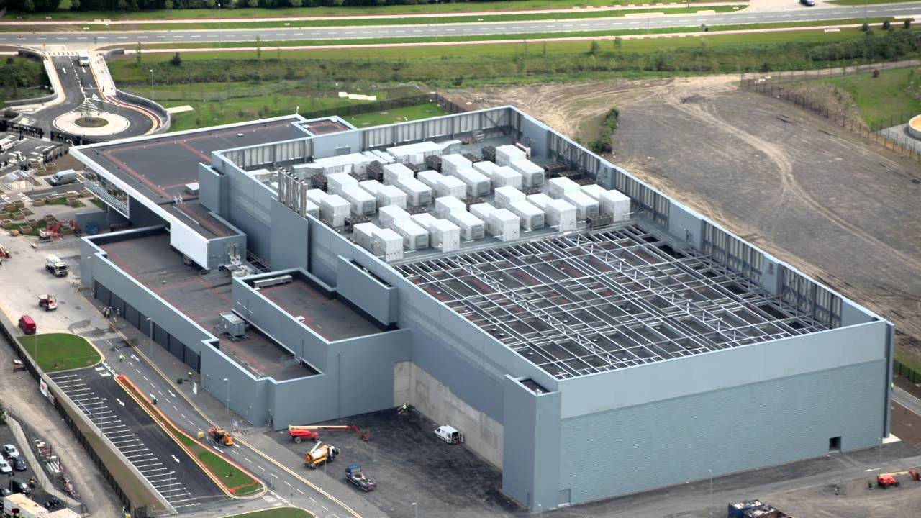
It’s everywhere
Notes:
The size of it is bigger than a football ground.

Slide 12
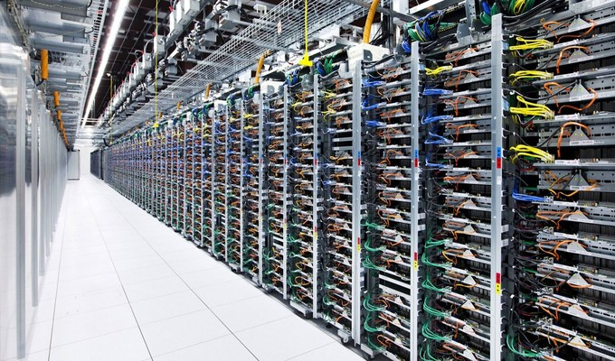


Slide 13

It delivers unmatched productivity
Any developer or IT professional can be productive with Azure. Azure’s integrated tools, pre-built templates, and managed services make it easier to build and manage enterprise, mobile, web, and Internet of Things (IoT) apps faster, using skills developers and IT professionals already have and technologies they already know.

Slide 14
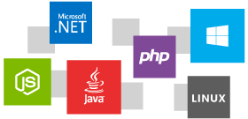
It’s open and flexible
Azure supports the broadest selection of operating systems, programming languages, frameworks, tools, databases and devices. Run Linux and Docker containers; build apps with JavaScript, Python, .NET, PHP, Java, Node.js; build backends for iOS, Android, and Windows devices. Azure supports the same technologies millions of developers and IT professionals already rely on and trust.

Slide 15
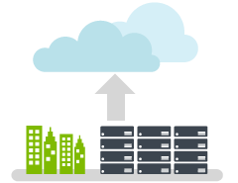
It works with existing IT
Notes:
We can move your exisiting Infra to the Cloudand also can go for hybrid option.

Slide 16

It’s ready for any business
Notes:
It is ready for any Business with a Proper SLA commitement

Slide 17

It’s economical and scalable
Azure’s pay-as-you-go services can quickly scale up
or down to match demand, so you only pay for what you use.
Notes:
Oay as you go model makes it super economical and can quickly scale up and down when needed without any downtime

Slide 18

It enables you to unlock insights
Azure’s predictive analytics services like Machine Learning, Power BI and Stream Analytics are redefining business intelligence. Make smarter decisions, improve customer service, and uncover new business possibilities from your structured, unstructured, and streaming Internet of Things data.

Slide 19



Cloud Computing
IaaS
PaaS
SaaS
Infrastructure-as-a-Service
Platform-as-a-Service
Software-as-a-Service
host
build
consume
Notes:
There are three flavours or category of Cloud computing - I think it is very important for a Infra person to understand the difference between IAAS and PASS. There is never pone as a solution. You have to combine both in order to achieve the best solution for your problem.
There fore on day one I will demonstrate few pass application step by step to make you understands the difference and benefits of each of the component.

Slide 20
On Premises
Infrastructure
(as a Service)
Platform
(as a Service)
Software
(as a Service)
You manage
Applications
Applications
Applications
Applications
Data
You manage
Data
Data
Data
Runtime
Runtime
Runtime
Runtime
Managed by Microsoft
You manage
Middleware
Middleware
Middleware
Managed by Microsoft
Middleware
O/S
O/S
O/S
O/S
Managed by Microsoft
Virtualization
Virtualization
Virtualization
Virtualization
Servers
Servers
Servers
Servers
Storage
Storage
Storage
Storage
Networking
Networking
Networking
Networking
Notes:
Slide Objectives:
Explain the differences and relationship between IaaS, PaaS, and SaaS in more detail.
Speaking Points:
Here’s another way to look at the cloud services taxonomy and how this taxonomy maps to the components in an IT infrastructure.
Packaged Software
With packaged software a customer would be responsible for managing the entire stack – ranging from the network connectivity to the applications.
IaaS
With Infrastructure as a Service, the lower levels of the stack are managed by a vendor. Some of these components can be provided by traditional hosters – in fact most of them have moved to having a virtualized offering.
Very few actually provide an OS
The customer is still responsible for managing the OS through the Applications.
For the developer, an obvious benefit with IaaS is that it frees the developer from many concerns when provisioning physical or virtual machines.
This was one of the earliest and primary use cases for Amazon Web Services Elastic Cloud Compute (EC2).
Developers were able to readily provision virtual machines (AMIs) on EC2, develop and test solutions and, often, run the results ‘in production’.
The only requirement was a credit card to pay for the services.
PaaS
With Platform as a Service, everything from the network connectivity through the runtime is provided and managed by the platform vendor.
The Windows Azure best fits in this category today.
In fact because we don’t provide access to the underlying virtualization or operating system today, we’re often referred to as not providing IaaS.
PaaS offerings further reduce the developer burden by additionally supporting the platform runtime and related application services.
With PaaS, the developer can, almost immediately, begin creating the business logic for an application.
Potentially, the increases in productivity are considerable and, because the hardware and operational aspects of the cloud platform are also managed by the cloud platform provider, applications can quickly be taken from an idea to reality very quickly.
SaaS
Finally, with SaaS, a vendor provides the application and abstracts you from all of the underlying components.

Slide 21
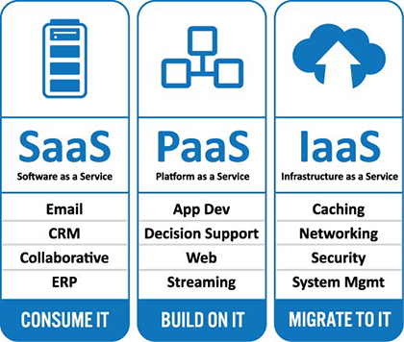
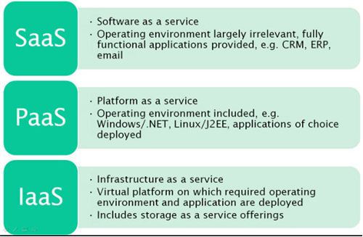

Slide 22
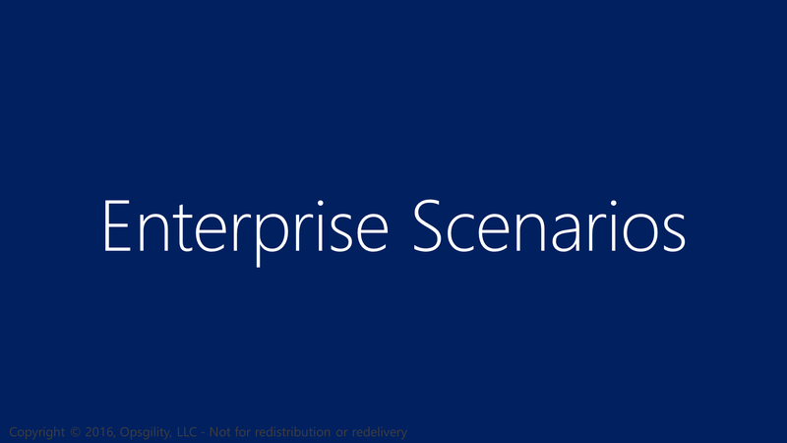
Enterprise Scenarios

Slide 23
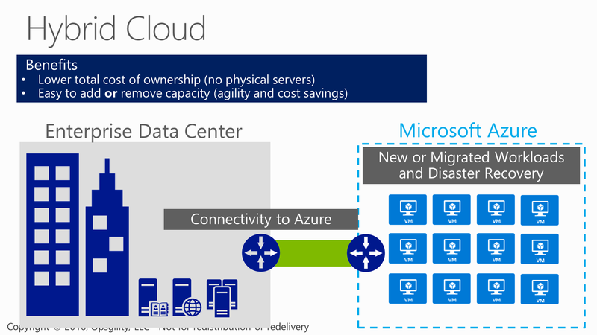
Hybrid Cloud

Slide 24
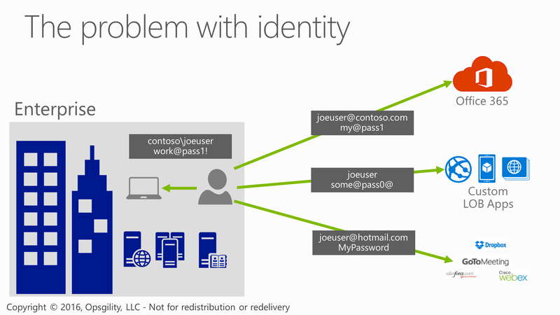
The problem with identity
Notes:
Traditionally Active Directory had solved the issues of having one user name and password. With the proliferation of the internet and services from Cloud providers this has become a huge issues for enterprises. Today people have many user names and leverage services across the web to get their jobs done.

Slide 25
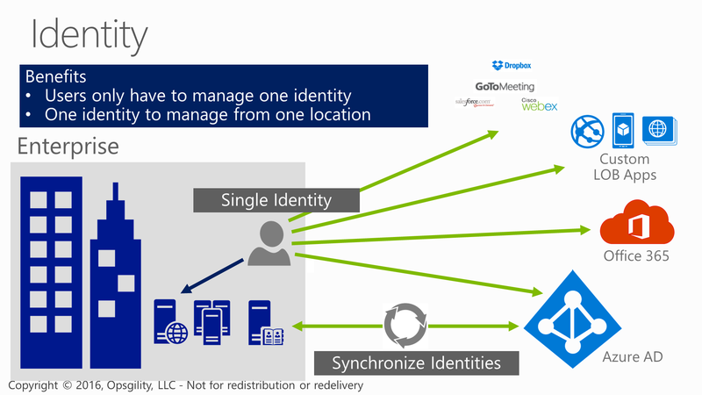
Identity
Notes:
Using Azure AD and Active Directory together Microsoft has an Enterprise grade turn key solution to these issues. Now corporations can provide access across thousands of website or corporate apps using just the credentials provisioned or removed from Active Directory.

Slide 26
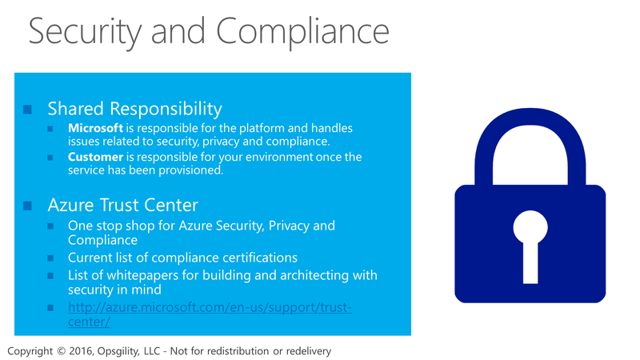
Security and Compliance
Notes:
Microsoft has a long history of running data centers going all the way back to 1989 when the first launched MSN. Microsoft also has a very vested interest in security – going back to 2004 with the implementation of the security development lifecycle due to attacks like Code Red and Slammer where they reorganized their entire software development lifecycle to integrate security as a core tenant.
Visiting the Azure trust center you can see the compliance certifications, the contractual obligations they are under and the details on how they physically and virtually secure the Microsoft Azure data centers.

Slide 27
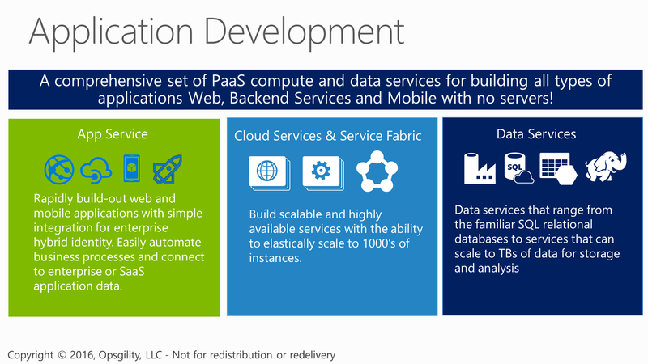
Application Development

Slide 28
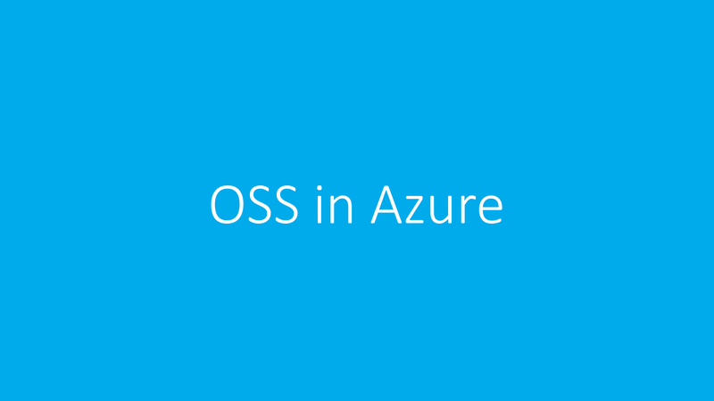
OSS in Azure
http://open.microsoft.com/
Notes:
http://open.microsoft.com/
Microsoft is embracing the Open source standards and interoperability would request you to go the the following site open.microsoft.com for more information and further details.

Slide 29
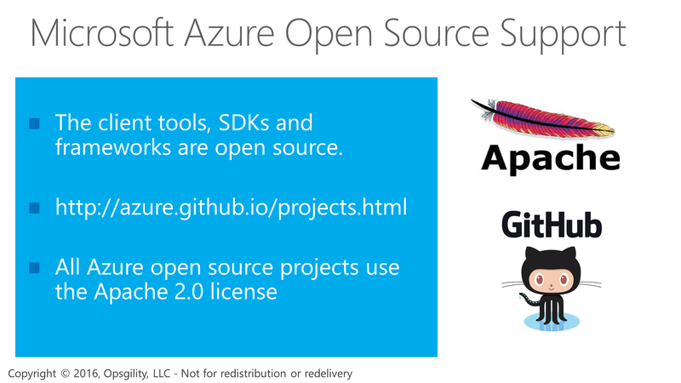
Microsoft Azure Open Source Support

Slide 30
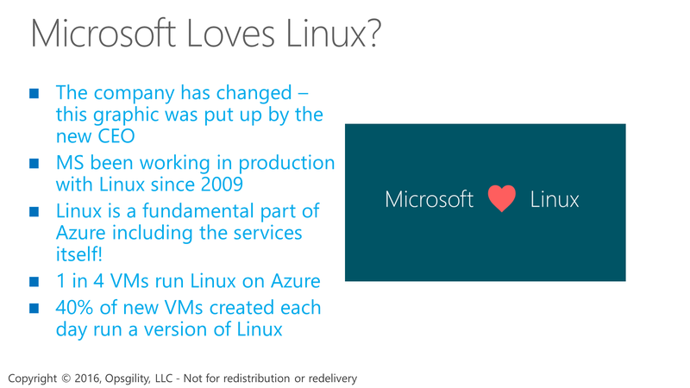
Microsoft Loves Linux?

Slide 31
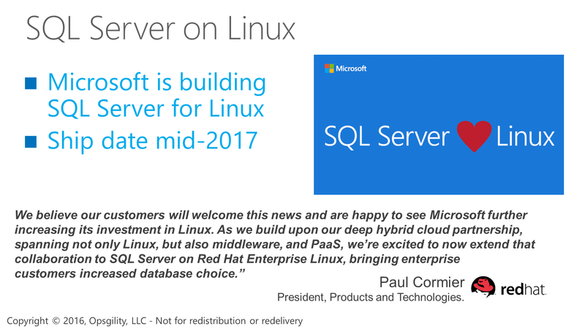
SQL Server on Linux

Slide 32
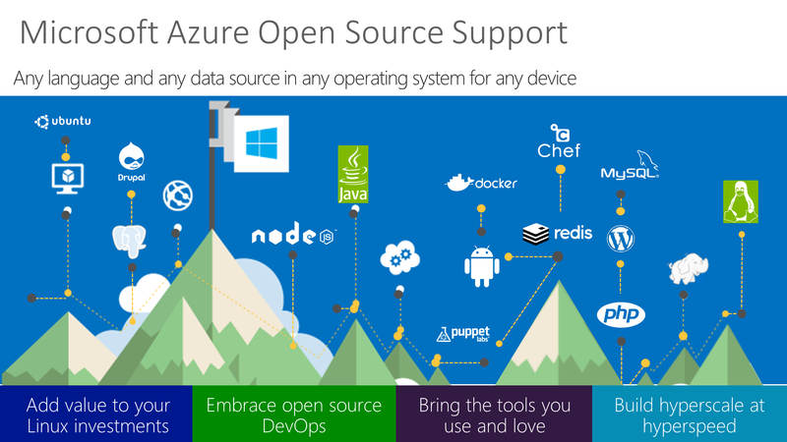
Microsoft Azure Open Source Support

Slide 33
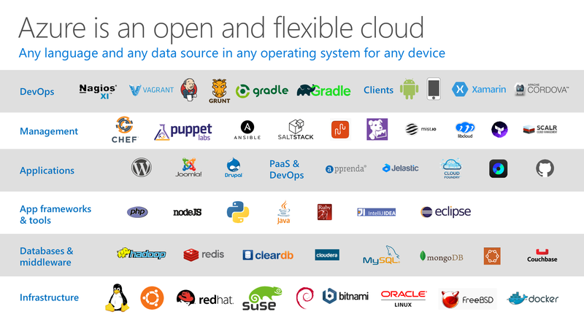
Notes:
P2

Slide 34
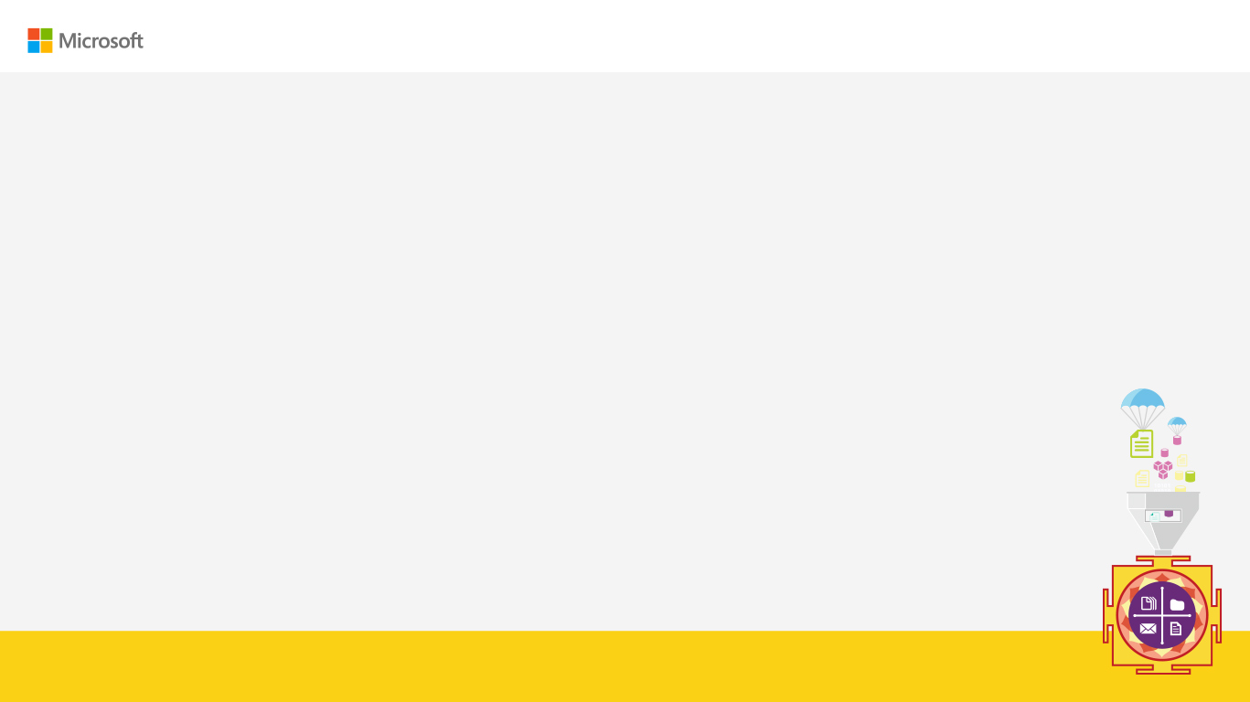

Enter Text
Thanks for Joining!!
Abdul Rasheed Feroz Khan
Feel free to reach me for any queries:
@TechFero | @CodeSizzler
developer.fero@outlook.com

